Slide 1
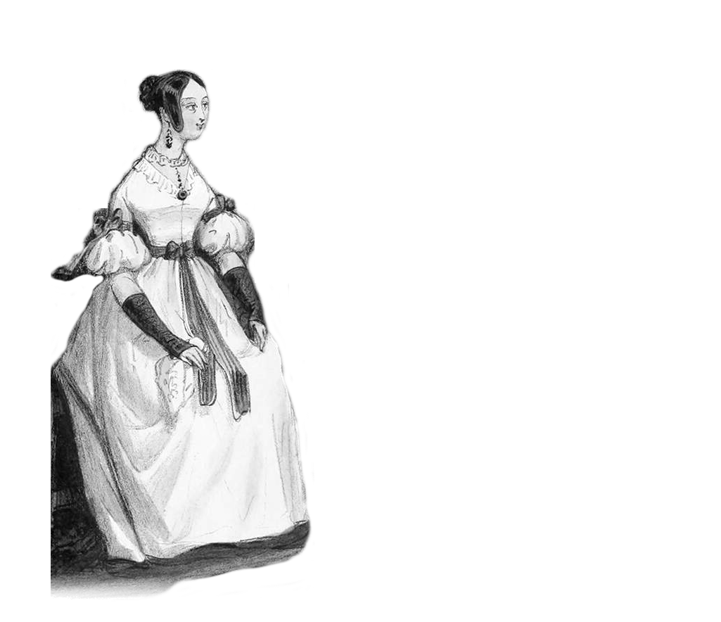
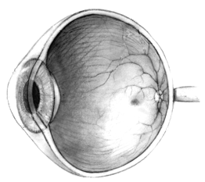
Your eye
My image
My data?
Your data?
Data about me?
Me

Slide 2
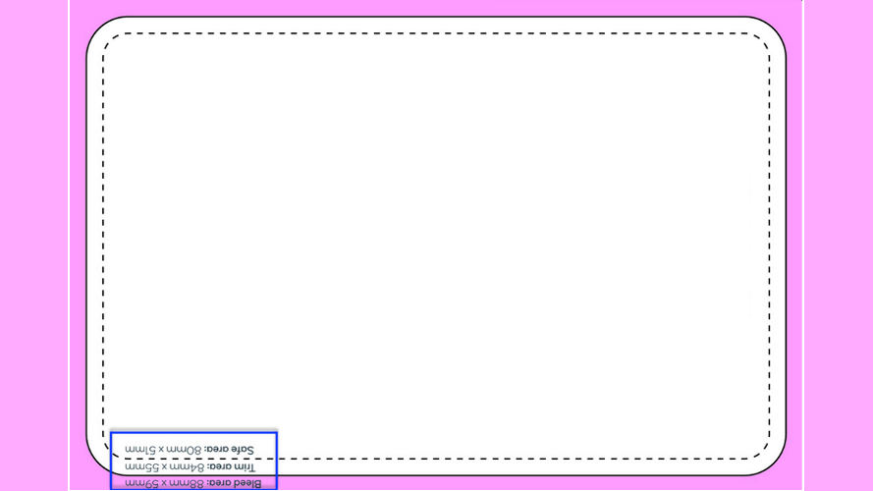
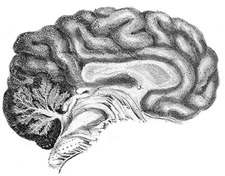
Your eye
Your brain
My image
My data?
Your data?
Data about me?
My image
My data?
Your data?
Data about me?
Me

Slide 3
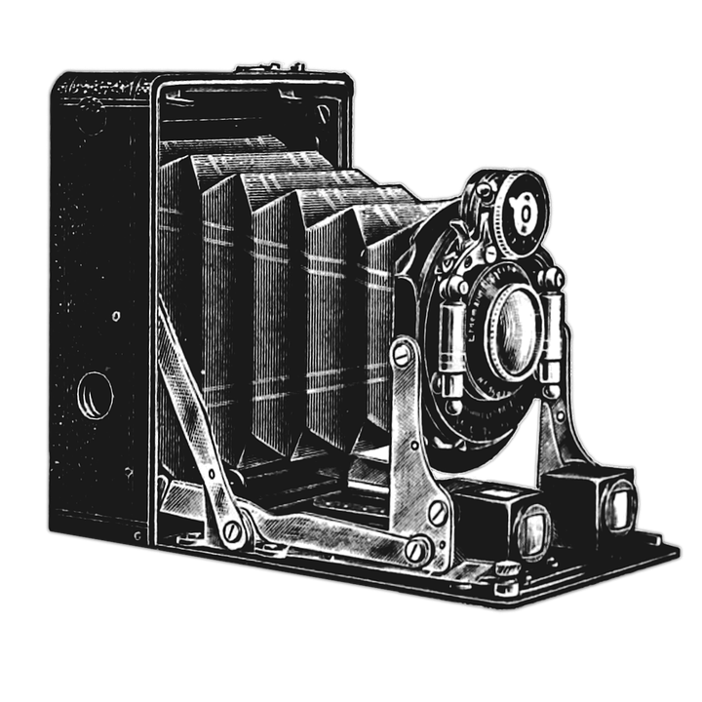
Your camera
My image
My data?
Your data?
Data about me?
Me

